Slide 1



AngularJS Directives
Defining Custom Directives
SoftUni Team
Technical Trainers
Software University
http://softuni.bg

Slide 2


Table of Contents
What is Directive?
Uses for Directives
Creating Directives
Isolating Directive Scope
Handling Events with Directives
Using Controllers with Directives
Using jQuery in Directives

Slide 3
What is a Directive in Angular?

Slide 4
What is a Directive?
Directives == markers on a DOM element
Attribute / element name / CSS class / comment
E.g. ng-view, ng-model, ng-bind, ng-class, …
Extends the standard HTML behaviour
Can define domain-specific tags (e.g. <order></order>)
Easier to read the HTML code
Cross-browser "web components" functionality

Slide 5
Uses of Directives
Custom elements
E.g. <div ad-box>…</div>
Custom events
E.g. define onclear event
Observe and react to changes
E.g. make and uppercase-only input field

Slide 6
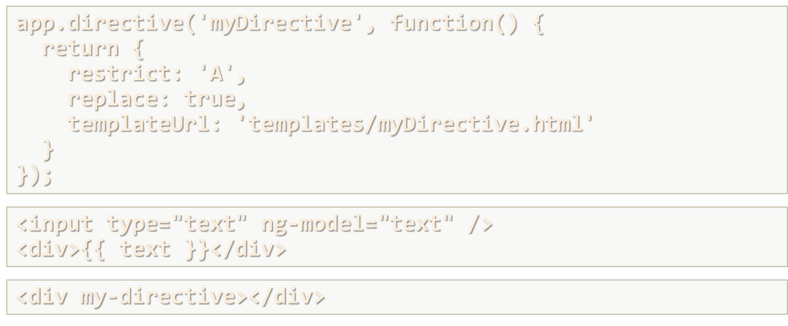
Defining Directives in Angular

Slide 7
Creating Directives
Directive
app.directive('myDirective', function() {
return {
restrict: 'A',
replace: true,
templateUrl: 'templates/myDirective.html'
}
});
'E‘: Element,
'A‘: Attribute,
'C‘: Class,
'M‘: Comment
Replace element with the template
Template
<input type="text" ng-model="text" />
<div>{{ text }}</div>
HTML
<div my-directive></div>

Slide 8
Defining Directives in Angular
Live Demo

Slide 9
Isolating Directive Scope
We can only use directive once within a given scope
Directives use parent scope
We can create new scope (isolated scope)
app.directive('adBox', function () {
return {
templateUrl: '/templates/directives/adBox.html',
scope: { ad: "=" }
}});
Isolated scope: '&', '@', '='
<div ad-box ad=ad></div>

Slide 10
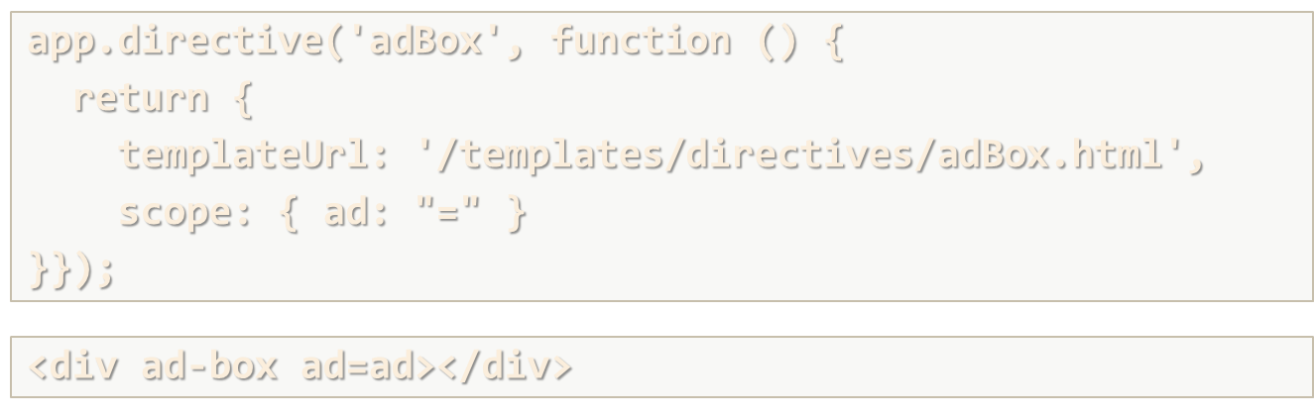
Isolation Directive Scope
Live Demo

Slide 11
Using Controllers with Directives
app.directive('myDirective', function () {
return {
template: '<button ng-click="showAlert()">Show alert</button>',
controller: 'MyController'
}});
app.controller('MyController', function ($scope) {
$scope.showAlert = function() {
alert('Hello SoftUni Friends!');
}
});

Slide 12
Handling Events with Directives
<input type="text" validate-symbols />
app.directive('validateSymbols', function() {
return {
restrict: 'A',
link: function(scope, element, attrs, controller) {
element.on('keydown', function(event) {
if(event.keyCode >= 97 && event.keyCode <= 122) {
return true;
}
return false;
})
}}});
You can type only lowercase English letters

Slide 13
Using jQuery in Directives
<input type="text" date-picker />
app.directive('datePicker', function() {
return {
restrict: 'A',
link: function(scope, element) {
element.datepicker();
}
}
});
Add datepicker to the current element

Slide 14


Summary
How you can restrict directive to be used as element?
restrict: 'E'
What are the two ways to specify the HTML used by your directive?
template and templateUrl
How would you handle an element event with directive?
link function with element.on('eventName', …)
SPA with AngularJS

Slide 15









AngularJS Directives
https://softuni.bg/courses/spa-applications-angularjs

Slide 16
License
This course (slides, examples, demos, videos, homework, etc.) is licensed under the "Creative Commons Attribution-NonCommercial-ShareAlike 4.0 International" license
Attribution: this work may contain portions from
"SPA with AngularJS" course by Telerik Academy under CC-BY-NC-SA license

Slide 17





Free Trainings @ Software University
Software University Foundation – softuni.org
Software University – High-Quality Education, Profession and Job for Software Developers
softuni.bg
Software University @ Facebook
facebook.com/SoftwareUniversity
Software University @ YouTube
youtube.com/SoftwareUniversity
Software University Forums – forum.softuni.bg

